Slide 1
Government Investment in Decarbonising Industry (GIDI) Fund – Round 5
Supplier Briefing for RFP released Thursday, 10 November 2022
Deadline for Questions: Thursday, 21 February 2023
Deadline for Proposals: Thursday, 03 March 2023

Slide 2
An Opportunity to Decarbonise - Welcome
Emissions abatement is our north star
Energy efficiency first
Supporting Medium to Large business
Public good funding to bridge the gap
Ensure your financials are robust
Focus on process heat
Aiming for a record-breaking round!
“…an ambitious package to help slash emissions in the energy sectors…”

Slide 3
Nicki Sutherland
EECA GM Investment & Engagement
Welcome
Vince Smart
EECA Lead Advisor – Evidence, Insights & Innovation
Financial Assessment Template walkthrough
Janine Kerr
EECA GIDI Fund Product Lead
GIDI Fund Overview, RFP
Michael Henry
EECA Business Manager
Process Heat subject matter expert
Simon Brash
EECA Information and Platforms Lead
The Response Form, questions from the floor

Slide 4
Housekeeping
Live Q&A will be open and visible throughout the session – we will keep an eye on what comes through and answer as many questions as possible at the end of the presentation
You have access to your camera but mics will be disabled for duration of the webinar
The webinar is being recorded and will be made available in the coming days
We expect this webinar to run 45mins to an hour

Slide 5
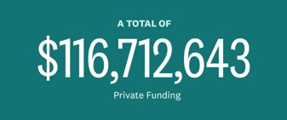
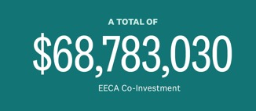
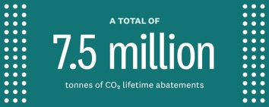
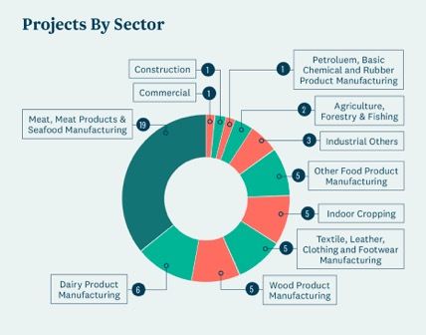
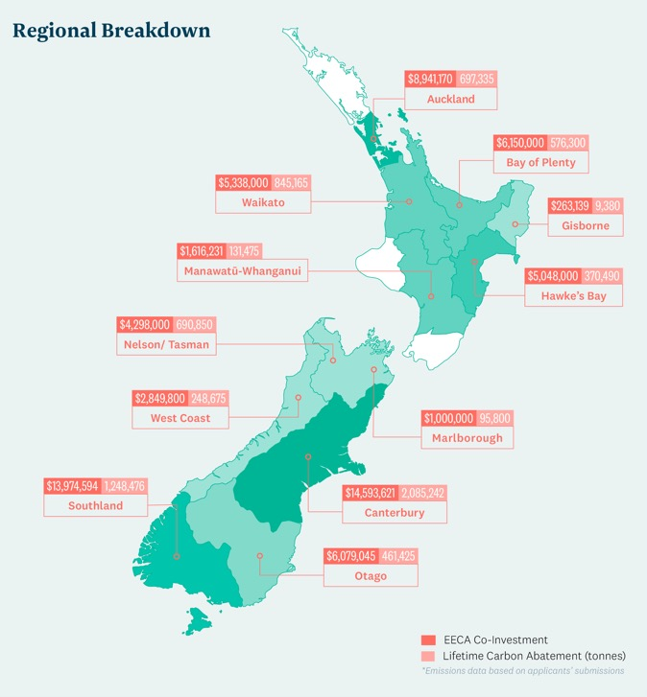
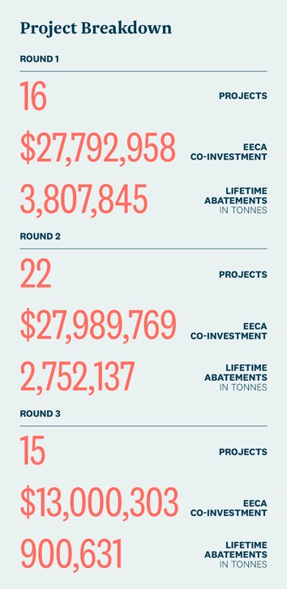
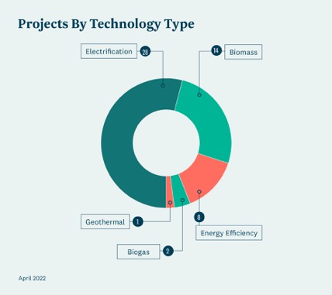
GIDI round 4 stats are currently being collated.

Slide 6
What are we looking for?
Proposals from NZBN registered private sector businesses committed to moving away from fossil fuels and decarbonising their industrial heat processes but where Government co-funding will accelerate the change.
Minimum Funding Conditions
Minimum project size $300,000; and
Government co-funding limited to 50% of eligible project cost; and
Applications for funding must be for the incremental capitalised project costs, not operating cost; and
Projects must be fully commissioned and operational by 31 December 2027.
“…there’s a growing list of businesses keen to hurry up and decarbonise…but
cashflow can be a barrier…”

Slide 7
What is not eligible?
Residential or commercial buildings and campuses
Transport initiatives
Waste minimisation
Electricity generation
Reducing agricultural emissions or embodied carbon
Displacing one fossil fuel for another (e.g. coal to natural gas)
Greenfields developments*
R&D, or using technologies not commercially available
Any ongoing financial liability for EECA
BAU costs e.g. existing staff
Unsure if your Proposal is out of scope?
?
Contact us at GIDIFund@eeca.govt.nz to discuss.
In addition to existing funding streams, we are working on a range of new products, particularly for smaller projects.

Slide 8
Demonstrate that you meet the Proposal Requirements
Eligible entity and the project
Ensuring long-term outcomes for the energy system
Decarbonisation outcomes
Projects where the total energy related carbon emissions by fuel type of the applicant entity, cumulated for all operating sites, is >1,000 tCO2e per year and requests over $10M.
Financial parameters
Health, safety, reputation
Innovative solutions
Approvals and sources of co-funding
Notes:
Eligible entity and the project
New Zealand-based and NZBN registered private sector business.
Delivered in new Zealand.
Project relieinformation provided.
Response form completed in full - with s on commercially available and proven technologies.
Supporting
all attachments.
Financial and technical due diligence passed/capable of assessment.
Decarbonisation outcomes
Reduces or enables the reduction of the energy used and/or carbon emitted during an industrial process.
Generates carbon emissions savings by reducing or avoiding fossil fuel use.
Carbon emissions savings are additional to what would have happened if the project did not occur, or occurred in a different manner or time.
Financial parameters
Payback period that is no less than two years with co-funding.
Project abatement costs clearly set out.
Incremental cost of project only.
Health, safety, reputation
Committed with appropriate systems and processes in place.
Cognisant of EECA’s reputation.
Approvals and sources of co-funding
Demonstrate ability to co-fund the remainder of the total cost of the project either directly or by utilising other funding sources.
Identifies all co-investment sources, including individual amounts if multiple sources.
Internal approval processes on track.
Ensuring long-term outcomes for the energy system
18. Woody biomass use will be predominately limited to medium and high temperature end uses (i.e. >100C).
Projects where the total energy related carbon emissions by fuel type of the Applicant entity, cumulated for all operating sites, is > 1,000 tCO2e per year
Demonstrates the project fits into a decarbonisation pathway, such as EECA’s energy transition accelerator programme or a suitable equivalent.
Provides evidence of the confidence in the ongoing and long term supply of renewable fuel required for the project.
Requesting >$10m? Special conditions may apply e.g., A decarbonisation partnership agreement with EECA, or a non-standard funding agreement may be requested.
Innovative solutions
Demonstrate a level of 9 or more on the technology readiness level (TRL) scale.
Presents a potential for replication that will realistically result in carbon emissions reduction by 2030.

Slide 9
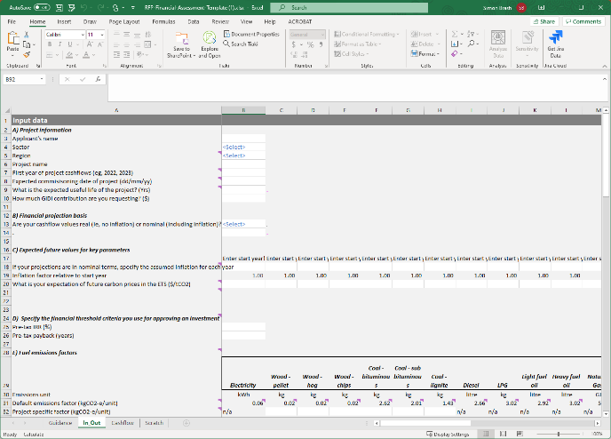
The Financial Assessment Template (FAT)
You'll want to check this out early in the process, as some data needed in the Response Form is calculated for you in the Financial Assessment Template
Upload completed template to the Response Form
The FAT enables EECA to evaluate all projects on a like-for-like basis
The evaluation:
Estimates CO2 abatement costs for both applicants and EECA
Helps us understand project economics and the case for funding
Provides evidence for project additionality
Tests for ‘unusual’ cost assumptions

Slide 10
FAT structure – a walkthrough
In_Out tab:
Applicants enter basic information about the project, plus the future carbon prices you use to evaluate projects to reduce fossil use
Also presents the results of financial performance and CO2 abatement cost calculations
Cashflow tab: Where projections of costs and fuel consumption are entered
Information about two possible futures required:
If the project goes ahead – the ‘Preferred Project’
If the project doesn’t go ahead – the ‘Base Case’
Cost projections can be entered with inflation (‘nominal’ i.e. what you would expect to actually pay) or without inflation (‘real’ i.e. what you expect to pay in future converted to today's dollars)
Only ‘cash costs’ must be entered. E.g, depreciation should not be included in Opex, as it duplicates Capex.
Fuel-related opex costs are split out from other opex to enable EECA comparison of applicants’ fuel price assumptions. Fuel costs should be entered without carbon costs.
EECA will seek clarification of ‘unusual’ fuel price projections
Our account managers are here to provide assistance with this, please reach out to GIDIFund@eeca.govt.nz with questions.

Slide 11
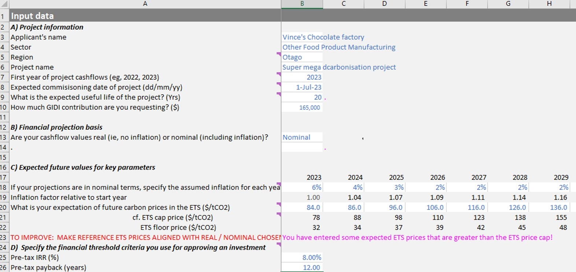
FAT examples
Inputs in the In-Out tab

Slide 12
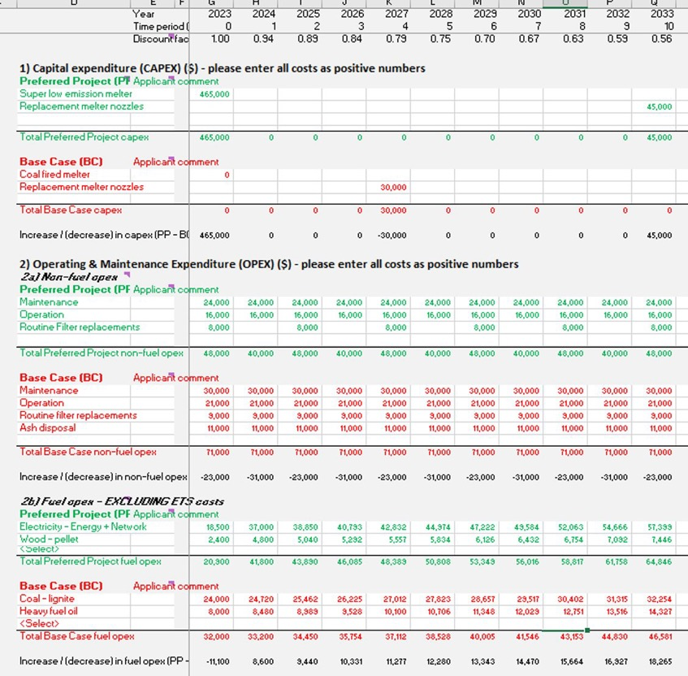
FAT examples
Inputs in the cashflow tab

Slide 13
Assessment and decision making
Process takes approx. 3 months from deadline to submit to notifying applicants
1
2
3
4
5
6
Applicant completes
the online Response Form
EECA reviews proposals
Technical Advisory Group evaluates proposals
Assessment Panel makes funding recommendations
Approval process
Applicants notified of outcome

Slide 14
Assessment Criteria
2. Co-funding ratio
3. Payback period
4. Abatement cost to the public
5. Speed of Implementation
6. Innovative Projects
1. Ability to Deliver
Assessment criteria
The RFP (section 5) shows applicants how to self-score the quantitative criteria, which the FAT will also calculate – the Response Form asks you to insert these scores which will be verified by the TAG.

Slide 15
Important dates
Date | Step
Thursday, 10 Nov 2022 | RFP released and proposals open
11am, Monday 21 Nov 2022 | Applicant briefing session
5pm, Thursday 09 Feb 2023 | Applicants’ deadline for questions
5pm, Thursday 16 Feb 2023 | EECA deadline to answer applicants’ questions
5pm, Thursday 02 March 2023 | Applicants’ deadline to submit proposals
May 2023 | - TAG & panel process - Panel recommendations and approvals
Within 30 business days of final approvals confirmed | Applicants notified of decisions

Slide 16
FAQs
Is there any point in submitting my application early?
Yes, EECA will start to process Response Forms for Round 5 once they are received but does not anticipate making any early decisions. We acknowledge the demands on businesses and consultants at this time of year and the RFP period enables you to choose to submit before or after the holiday season.
Can applicants that were successful in previous GIDI rounds reapply?
Yes, provided they continue to meet the Minimum Funding Conditions, and address the Proposal Requirements set out in the RFP.
Please visit the GIDI website for an extensive list of FAQs

Slide 17
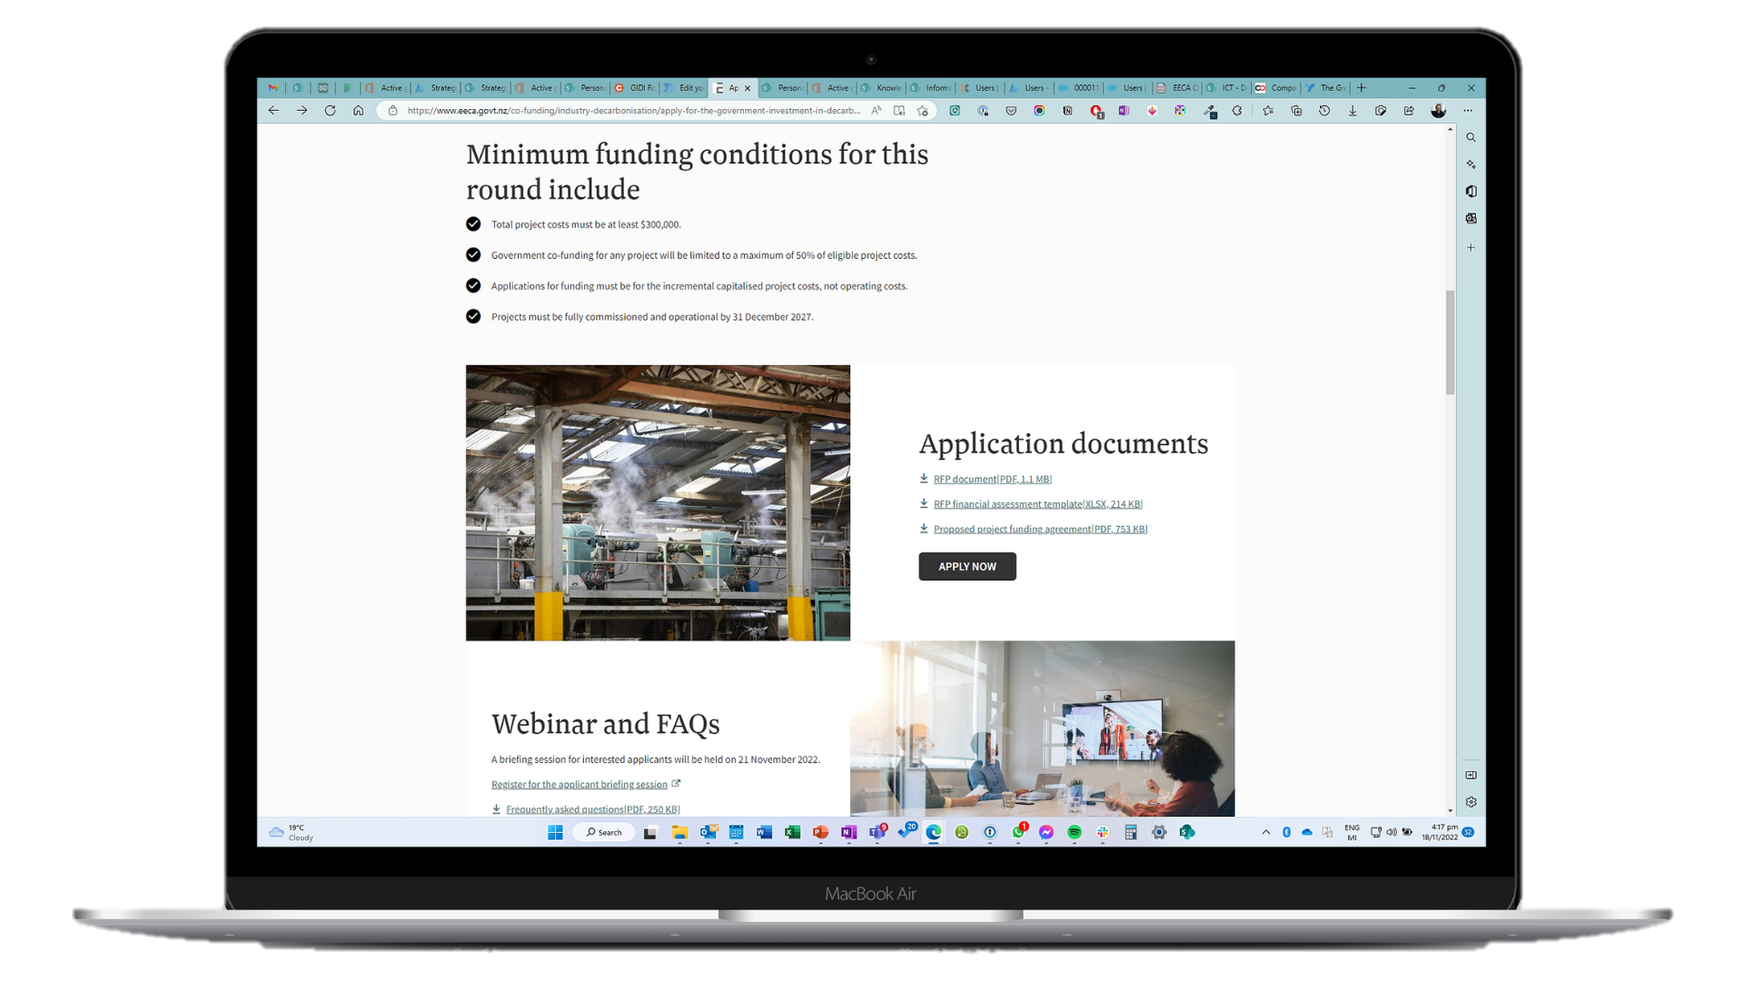
Ready to apply?
Go to eeca.govt.nz/co-funding/industry-decarbonisation: Apply for GIDI co-funding
Read the RFP in full, pay close attention to the Investment Principles & make sure your Proposal meets the Minimum Funding Conditions and that you can respond to the Proposal Requirements.
Click
Fill in the online Response Form, remember to have your business case/feasibility study, your project plan, and the EECA supplied Financial Assessment Template ready so these can be uploaded with the Response Form.
Contact GIDIFund@eeca.govt.nz with any questions.
Submit your Response Form by 5pm, 02 March 2023.
APPLY NOW
“…helping businesses move over to cleaner, more affordable, more efficient choices…”

Slide 18
Tips for using the online response form
Pay close attention to the ‘tips for using this online form’ on the welcome page
It’s long – get in early and familiarise yourself with how it works.
We have made a Word version of the Response Form available on the Welcome page for reference and drafting with your team.
Choose a “Response Form Owner” – someone to own the application process on your side.
Save as you go – when you click ‘save’ you will receive a unique link. Use this link to access your form from then on. The form saves every time you navigate between pages.
One at a time – if multiple people go in at the same time you risk overwriting each other’s work.
If you accidentally close the browser tab, pushing Ctrl-Shift-T will reopen it.

Slide 19
Questions from the floor

Slide 20
We’re here to answer any questions
GIDIFund@eeca.govt.nz.
Deadline for questions: 5pm, Thursday 16 February 2023

